Slide 1


http://www.comp.nus.edu.sg/~cs1010/
Lecturer’s slides
WEEK 13
Class Activities

Slide 2
Week 13: C to Java
Unit #20
Exercise #1: Washers
Exercise #2: Point Nearest to Origin
Wrapping Up
CS1010 Final Examination
How to Prepare for Exams?
Post-CS1010

Slide 3
Week 13 Programs
Download the programs from this web page
http://www.comp.nus.edu.sg/~cs1010/lect/prog/2014/week13_for_students
The files are:
Week13_washers.c
Week13_nearest_point.c
Week13NearestPoint.java
You may also copy the above files directly into your sunfire account using the following UNIX command, where xxx is the name of one of the above files:
cp ~cs1010/public_html/lect/prog/2014/week13_for_students/xxx .

Slide 4
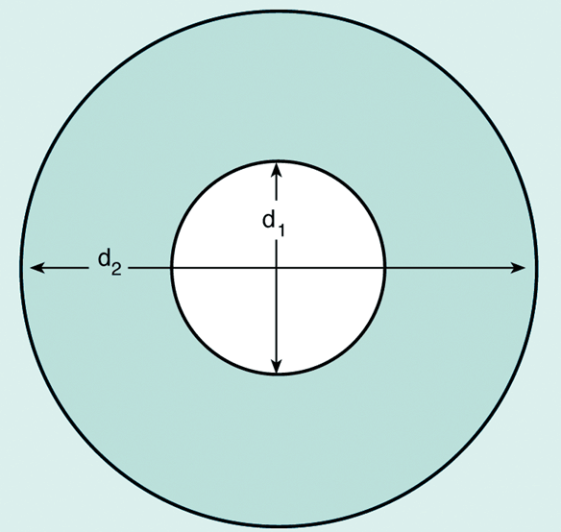
Exercise #1: Washers (1/5)
From Unit #4:
Case Study: You work for a hardware company that manufactures flat washers. To estimate shipping costs, your company needs a program that computes the weight of a specified quantity of flat washers.
rim area = π(d₂/2)² – π(d₁/2)²
Convert Week13_washers.c into a Java program Week13Washers.java
Follow Java naming convention in naming your variables and methods

Slide 5
Exercise #1: Washers (2/5)
Week13_washers.c
#include <stdio.h>
#include <math.h>
#define PI 3.14159
double compute_total_weight(double, double, double, double, int);
double circle_area(double);
int main(void) {
double d1, d2, thickness, density, total_weight;
int qty;
printf("Inner diameter in cm: "); scanf("%lf", &d1);
printf("Outer diameter in cm: "); scanf("%lf", &d2);
printf("Thickness in cm: "); scanf("%lf", &thickness);
printf("Density in grams per cubic cm: "); scanf("%lf", &density);
printf("Quantity: "); scanf("%d", &qty);
total_weight = compute_total_weight(d1,d2,thickness,density,qty);
printf("Total weight of the batch of %d washers is %.2f grams.\n",
qty, total_weight);
return 0;
}

Slide 6
Exercise #1: Washers (3/5)
Week13_washers.c
// Compute total weight of a batch of washers given
// the number of washers, and the washers' data:
// outer diameter, hole diameter, thickness, and density
double compute_total_weight(double d1, double d2, double thickness,
double density, int qty) {
double rim_area = circle_area(d2) - circle_area(d1);
double unit_weight = rim_area * thickness * density;
return unit_weight * qty;
}
// Returns the area of a circle given its diameter
double circle_area(double diameter) {
return pow(diameter/2, 2) * PI;
}

Slide 7
Exercise #1: Washers (4/5)
Reveal after students have attempted.

Slide 8
Exercise #1: Washers (5/5)
Reveal after students have attempted.

Slide 9
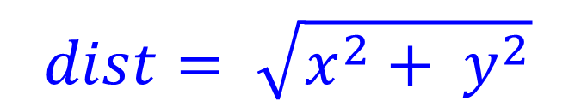
Exercise #2: Point Nearest to Origin (1/9)
Given a list of points, determine the point that is closest to the origin.
You may assume there are at least 1 and at most 10 points.
Distance of a point (x, y) from the origin:
$$dist= \sqrt{x^{2}+ y^{2}}$$
y-axis
(x, y)
y
x-axis
(0, 0)
x

Slide 10
Exercise #2: Point Nearest to Origin (2/9)
Enter number of points (at most 10): 6
12 100
9 65
81 50
43 77
61 8
6 108
Points: (12,100) (9,65) (81,50) (43,77) (61,8) (6,108)
Point nearest to origin: (61,8) with distance 61.522354

Slide 11
Exercise #2: Point Nearest to Origin (3/9)
Week13_nearest_point.c
#include <stdio.h>
#include <math.h>
#define MAX_PTS 10
int scan_points(int [], int []);
void print_points(int [], int [], int);
int nearest_point(int [], int [], int);
int main(void) {
int x[MAX_PTS], y[MAX_PTS];
int num_points, index;
num_points = scan_points(x, y);
print_points(x, y, num_points);
index = nearest_point(x, y, num_points);
printf("Point nearest to origin: (%d,%d)", x[index],y[index]);
printf(" with distance of %f\n",
sqrt(x[index]*x[index] + y[index]*y[index]));
return 0;
}

Slide 12
Exercise #2: Point Nearest to Origin (4/9)
Week13_nearest_point.c
// Read the points and return the number of points read.
int scan_points(int x[], int y[]) {
int size, i;
printf("Enter number of points (at most %d): ", MAX_PTS);
scanf("%d", &size);
for (i=0; i<size; i++) {
scanf("%d %d", &x[i], &y[i]);
}
return size;
}
// Print the points
void print_points(int x[], int y[], int size) {
int i;
printf("Points: ");
for (i=0; i<size; i++) {
printf("(%d,%d) ", x[i], y[i]);
}
printf("\n");
}

Slide 13
Exercise #2: Point Nearest to Origin (5/9)
Week13_nearest_point.c
// Return the index of the point nearest to the origin
// Precond: size > 0
int nearest_point(int x[], int y[], int size) {
int i, min_index = 0;
double min_dist = sqrt(x[0]*x[0] + y[0]*y[0]);
double dist;
for (i=1; i<size; i++) {
dist = sqrt(x[i]*x[i] + y[i]*y[i]);
if (dist < min_dist) {
min_dist = dist;
min_index = i;
}
}
return min_index;
}

Slide 14
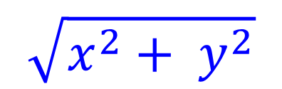
Exercise #2: Point Nearest to Origin (6/9)
Skeleton program Week13NearestPoint.java given
Check out the Math class in the API documentation http://docs.oracle.com/javase/7/docs/api/
Which Math method you may use for this formula?
$$\sqrt{x^{2}+ y^{2}}$$
Answer: double hypot(double x, double y)

Slide 15
Exercise #2: Point Nearest to Origin (7/9)
Week13NearestPoint.java
import java.util.*;
public class Week13NearestPoint {
private static final int MAX_PTS = 10;
public static void main(String[] args) {
int[] x = new int[MAX_PTS];
int[] y = new int[MAX_PTS];
int numPoints, index;
numPoints = scanPoints(x, y);
printPoints(x, y, numPoints);
index = nearestPoint(x, y, numPoints);
System.out.print("Point nearest to origin: (" + x[index]
+ "," + y[index] + ") ");
System.out.println(" with distance "
+ Math.hypot(x[index], y[index]));
}

Slide 16
Exercise #2: Point Nearest to Origin (8/9)
Reveal after students have attempted.
Week13NearestPoint.java
// Read the points and return the number of points read.
public static int scanPoints(int[] x, int[] y) {
Scanner sc = new Scanner(System.in);
System.out.printf("Enter number of points (at most "
+ MAX_PTS + "): ");
int size = sc.nextInt();
for (int i=0; i<size; i++) {
x[i] = sc.nextInt();
y[i] = sc.nextInt();
}
return size;
}
// Print the points
public static void printPoints(int[] x, int[] y, int size) {
}

Slide 17
Exercise #2: Point Nearest to Origin (9/9)
Reveal after students have attempted.
Week13NearestPoint.java
// Fill in the code for printPoints()
// Return the index of the point nearest to the origin
// Precond: size > 0
public static int nearestPoint(int[] x, int[] y, int size) {
int min_index = 0;
return min_index;
}
}

Slide 18
CS1010 Final Examination (1/2)
CS1010 Exam
26 November 2014, Wednesday, 5 – 7pm
Venue: To be announced by Registrar’s Office
Format
MCQs section: 6 questions (12 marks)
Short questions section: 3 questions (14 marks)
Problem solving section: 4 questions (54 marks)
Total: 80 marks
Grading of CS1010 is not based on bell curve

Slide 19
CS1010 Final Examination (2/2)
Instructions
Open book
No calculators, electronic dictionaries and devices
May use 2B pencil to write programs
Advice
Read instructions carefully and follow them!
Manage your time well!
A question may consist of several parts; the parts may be independent. If you are stuck on one part, move on to the next.

Slide 20

How to Prepare for Exams?
Try past-years’ exam papers
Answers not provide
Please discuss on IVLE forum
Preparing for Exams: A Guide for NUS Students
http://www.cdtl.nus.edu.sg/examprep/

Slide 21
Post-CS1010 (1/3)
For CEG: CS1010 → CS1020
For CS: CS1010 → CS1020 → CS2010 or CS1010 → CS2020 (accelerated) *
CS1020 Data Structures and Algorithms 1
Emphasis on algorithms and data structures
Using Java, an object-oriented programming language
Textbook: Data Abstraction & Problem Solving with Java: Walls and Mirrors by Janet J. Prichard and Frank M. Carrano, 3rd edition (based on last year’s information, subject to change)
Website: http://www.comp.nus.edu.sg/~cs1020

Slide 22
Post-CS1010 (2/3)
Topics covered (based on last year; subject to change)
Topics may not be covered in this sequence
Topics
Java
Abstract Data Types (ADTs)
Linked Lists
Stacks and Queues
Recursion
Algorithm Analysis
Sorting
Hashing
Mix and Match

Slide 23



Post-CS1010 (3/3)
CS1020 has sit-in labs (like mini-PEs) every other week
Important: Strengthen your programming skills to prepare for CS1020

Slide 24

Things-To-Do
Keep an eye on the IVLE announcements on your CA marks
Participate in IVLE forums
Try out past years’ exam papers
No solutions provided
Post on forums for clarification/discussion

Slide 26
End of File

